Slide 1
Subnetting

Slide 2
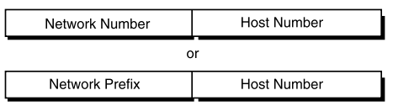
Classful IP Addressing
When IP was first standardized in September 1981, the specification required that each system attached to an IP-based Internet be assigned a unique, 32-bit Internet address value.
The first part of an Internet address identifies the network on which the host resides, while the second part identifies the particular host on the given network.
This creates the two-level addressing hierarchy
All hosts on a given network share the same network prefix
but must have a unique host number

Slide 3
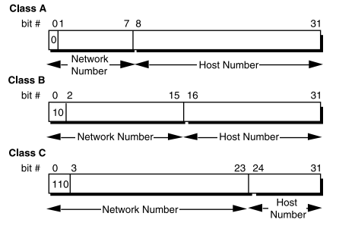
Primary Address Classes
Networks vary in sizes make three classes

Slide 4
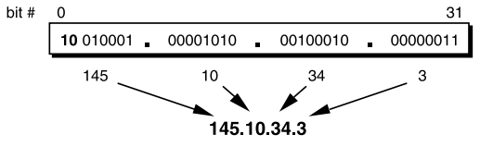
How many networks/host?
 | Networks | Hosts
Class A (High order bit =1) /8 | 2⁷-2 127=Loopback, 0=Default route | 2²⁴-2 All 0s= This network All 1s =Broadcast
Class B (High order bits=10) /16 | 2¹⁴ | 2¹⁶-2
Class C (High order bits=110) /24 | 2²¹ | 2⁸-1
Dotted Decimal Notation (Easy for Humans)

Slide 5
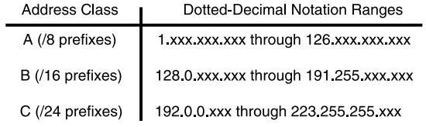
Dotted Decimal Notation ranges

Slide 6
Limitations to Classful Addressing
What is required vs. what is asked by organization → rapid depletion
Only 2³² (4,294,967,296 ) addresses available
No network class to support medium sized organization (say 400 hosts /network) [lets allocate /16 → premature depletion]
Router lengthy tables
For new network, organization requires other network number

Slide 7
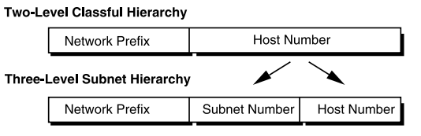
Subnetting
Divide the class further → 3 level hierarchy
Make routing tables short
Internet router has one entry
Subnetting private to organization
Organization can deploy additional networks without getting more network number from ICANN

Slide 8
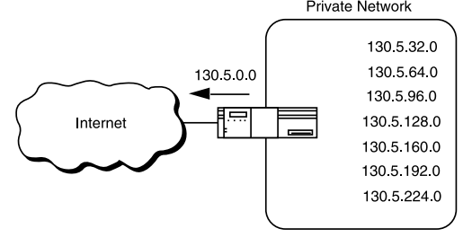
Subnetting
Organization can deploy additional networks without getting more network
number from ICANN
routing advertisements for all of the subnets are combined into a single routing table entry

Slide 9

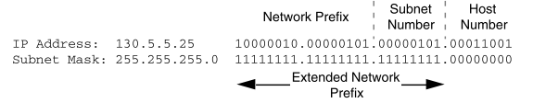
Extended Network Prefix
Internet routers use only the network prefix of the destination address to route traffic to a subnetted environment.
Routers within the subnetted environment use the extended network prefix to route traffic between the individual subnets.
SUBNET MASK → To identify extended network prefix

Slide 10
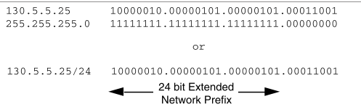
Extended Network Prefix length = subnet mask

Slide 11
Subnet Design Considerations
1 How many total subnets does the organization need today?
Lets 9 are required , 16 will be considered
2 How many total subnets will the organization need in the future?
BUT in two years might be 18, so make it 32 say
3 How many hosts are on the organization’s largest subnet today? 4 How many hosts will there be on the organization’s largest subnet in the future?
Lets understand with example

Slide 12
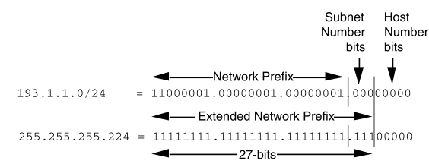
Example
An organization is assigned the network number 193.1.1.0/24 and it needs to define six subnets. The largest subnet is required to support 25 hosts.

Slide 13
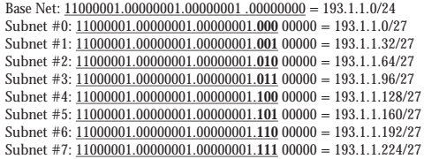
Example cont…
An easy way to verify that the subnets are correct is to ensure that they are all multiples of the Subnet #1 address. In this example, all subnets are multiples of 32: 0, 32, 64, 96, and so on.

Slide 14
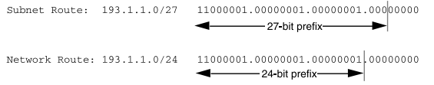
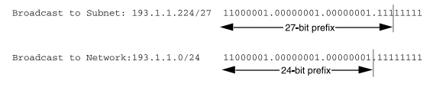
The All-0s Subnet and All-1s Subnet
Both situations confusing for router

Slide 15
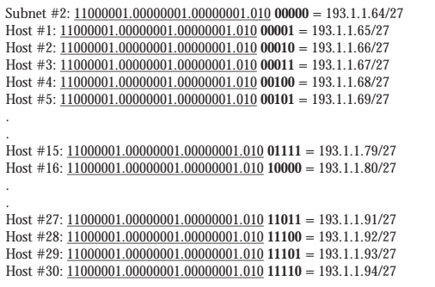
Defining Host Addresses for Each Subnet
In general, to define the address assigned to Host #N of a particular subnet, the network administrator places the binary representation of N into the subnet’s host number field. For example, to define the address assigned to Host #15 on Subnet #2, the network administrator simply places the binary representation of 15 (011112 ) into the 5-bits of Subnet #2’s host number field.

Slide 16
Defining Host Addresses for Each Subnet

Slide 17
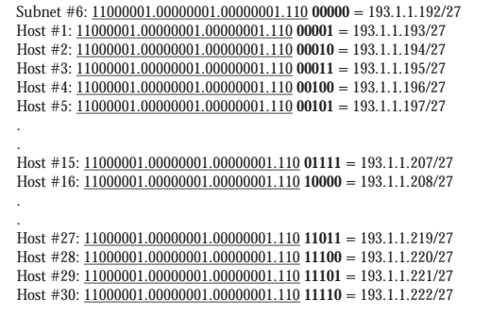
Defining Host Addresses for Each Subnet

Slide 18
Defining the Broadcast Address for Each Subnet
The broadcast address for Subnet #2 is the all-1s host address or:
11000001.00000001.00000001.010 11111 = 193.1.1.95
Note that the broadcast address for Subnet #2 is exactly one less than the base address for Subnet #3 (193.1.1.96). This is always the case-the broadcast address for Subnet #n is one less than the base address for Subnet #(n+1).
The broadcast address for Subnet #6 is simply the all-1s host address or: 11000001.00000001.00000001.110 11111 = 193.1.1.223
Again, the broadcast address for Subnet #6 is exactly one less than the base address for Subnet #7 (193.1.1.224).

